Slide 1
SIMULDATA

Slide 2

Solitude
Solitude is a state of seclusion or isolation, i.e., lack of contact with people. It may stem from:
bad relationships & loss of loved ones
deliberate choice
infectious disease & mental disorders
neurological disorders or circumstances of employment or situation (migratory flows)
Notes:
CONTEXTO:
-
-
Deep feeling of dispossession and rupture of personal and social relationships, perceived as negative and deprived of any expectation to be overcome.
○It can occur either in isolation situations or in other people’s environment.

Slide 3
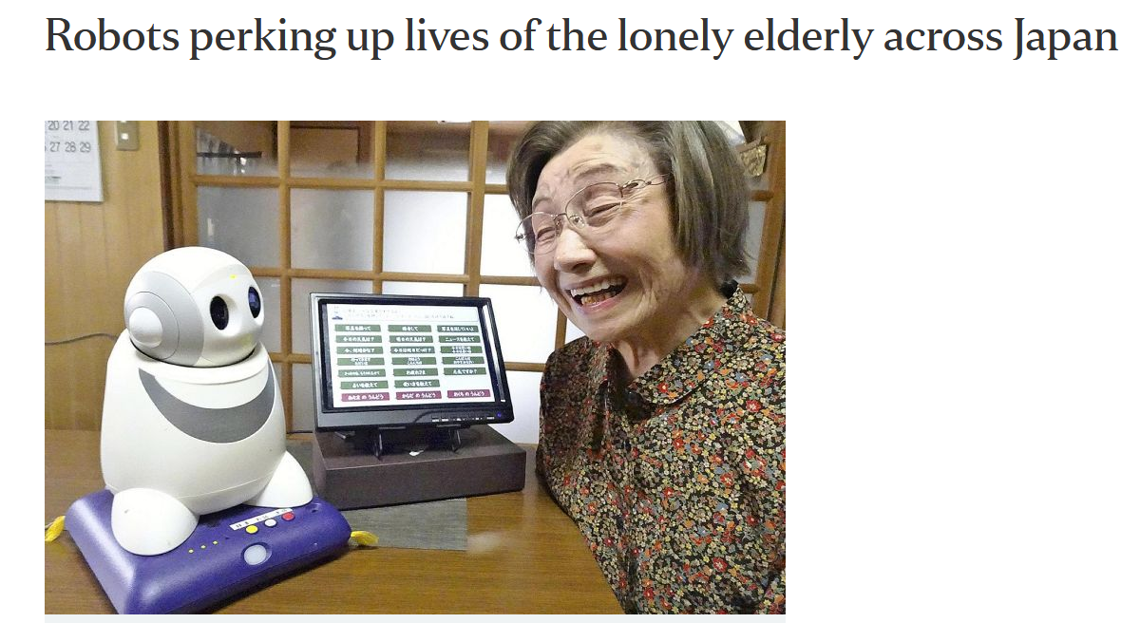
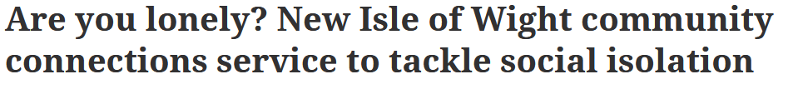
Loneliness
https://www.straitstimes.com/asia/east-asia/robots-perking-up-lives-of-the-lonely-elderly-across-japan
https://www.countypress.co.uk/news/18006920.lonely-new-isle-wight-community-connections-service-tackle-social-isolation/
Notes:
CONTEXTO:
-
-
Deep feeling of dispossession and rupture of personal and social relationships, perceived as negative and deprived of any expectation to be overcome.
○It can occur either in isolation situations or in other people’s environment.

Slide 4
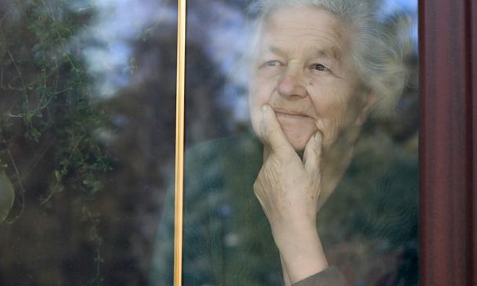
Factors
Economic (can avoid to participate various activities in the public sphere)
Medical ( prejudices about diseases: HIV and and type of disability may end up moving away from certain social dynamics)
Age
Geographic Conditions

Slide 5

Solutions
Volunteering can also be a great way to avoid social isolation: not only will you be tackling this problem of yours, but you will be helping those who need it most.
Human contact that encourage living in society and celebrate the moments of life and moments of healthy living (religious approach for example)
Group activities (meetups), cultural sports, meeting common interests, work involving the human workforce and teamwork

Slide 6
To solve a problem we must first identify it.
Who requires assistance?
What kind of assistance can we provide?
How efficient can we efficient?

Slide 7
Exploratory Data Analysis
Content Identification
TV and Phone usage data
45 Variables -> 14
Customer fix: high cardinality in some features (>100)
TV: Too many missing data (~50%)
High correlation between features
Rule of thump: replace missing values with 0!
Severely unbalanced dataset. Oversampling!

Slide 8
Results Visualization

Slide 9
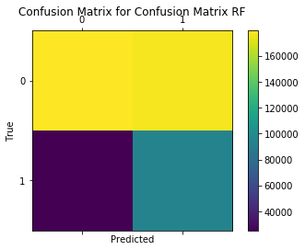
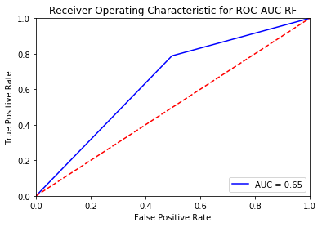
Random Forest Baseline Model
Confusion Matrix ROC-AUC Curve
The worse error is mitigated

Slide 10
Findings

Slide 11
VIP Features
Good predictors:
Kind of Telecom package (or lack thereof)
Being the decision maker

Slide 12
Geographically speaking

Slide 13
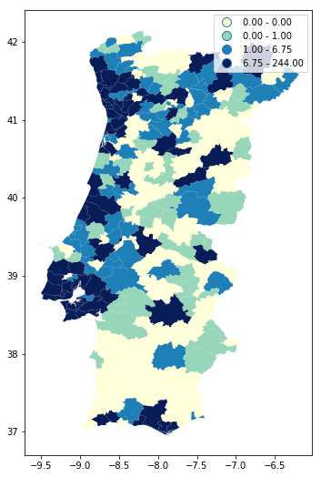
Isolated people per Parish
Urban Centers: Full with loners!
Rural Areas: Could be insufficent data

Slide 14
Prescriptive Challenge
Characterize options
Simplification and Heuristic
Improvements

Slide 15
Prescriptive Challenge
1st option
Door to Door
Cost per patient per month
(fixed monthly costs, serving a given number of people)
100 Visits per week (30km diameter) | ~75 euros
75 Visits per week (40km diameter) | ~110 euros
50 Visits per week (50km diameter) | ~180 euros

Slide 16
Prescriptive Challenge
2nd option
Call center + Video conference
Cost per patient per month
(cost is split between workers salary, facilities and camera)
20 call assistants (50 calls per week) | ~92 euros
100 call assistants (50 calls per week) | ~90 euros
500 call assistants (50 calls per week) | ~89 euros

Slide 17
Prescriptive Challenge
3rd option
Half day center + Video conference
Cost per patient per month
(Cost for half day facilities, call center facilities, salaries, cameras and travelling)
600 half-day activities | ~63 euros
900 half-day activities | ~62 euros
1200 half-day activites | ~61 euros

Slide 18
Heuristics

Slide 19
Heuristic
Minimize costs
Simplification: Select which options we would use
Goal: prioritize how the resources are spent and how can we have the highest beneficials

Slide 20
Improvements

Slide 21
Improvements
Include door-to-door service
Redirect the resourses in the best way, so that we can solve the major problems in our society.

